Slide 1

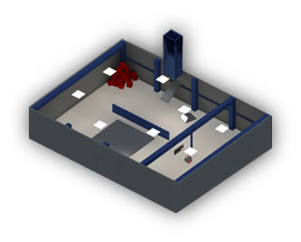
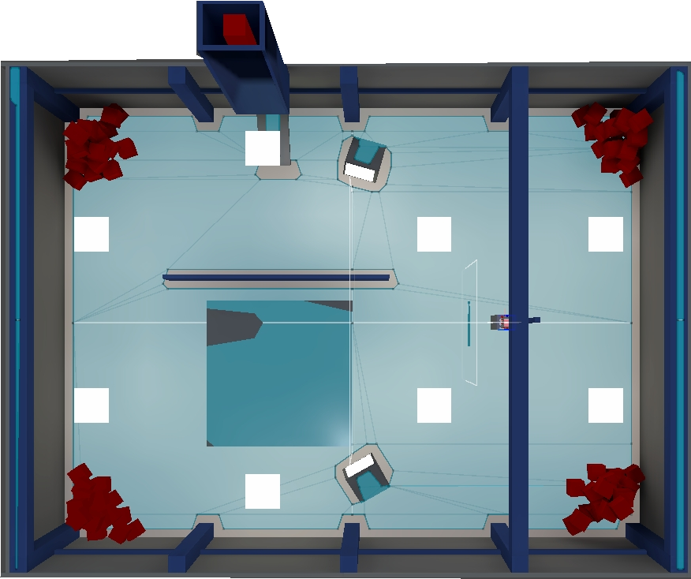
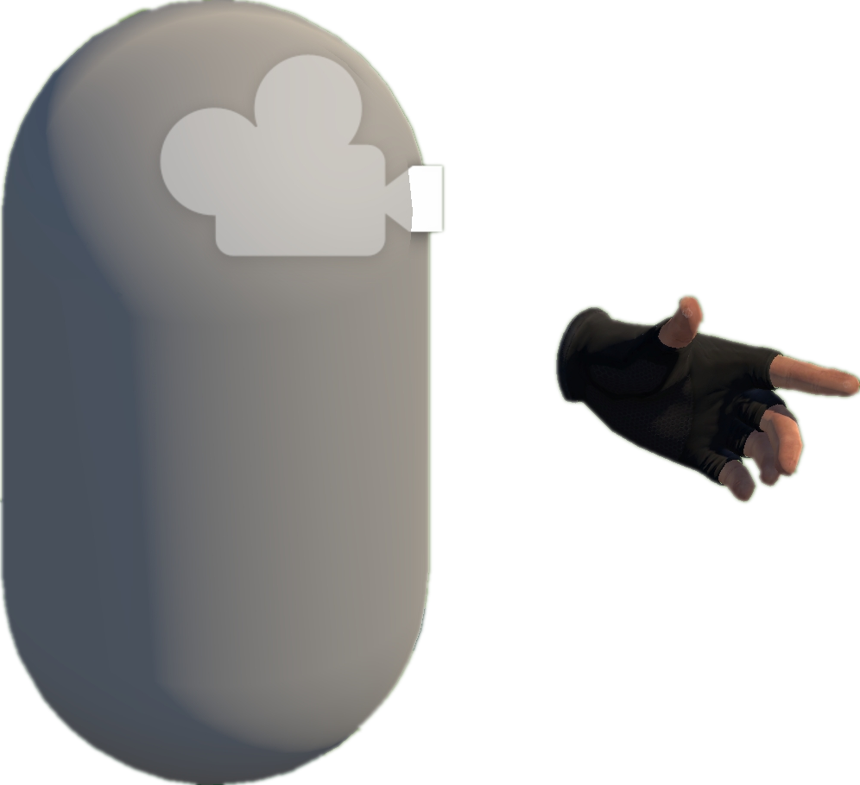








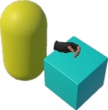
Project Collection
VRExplorer Test
Exploration and Interaction
Preliminary Scene Configuration
3
Open Source Repositories
1
Camera
Tags & Topics
Hand Controller
Bake NavMesh
Collider
Unity-based Projects
Original Scene
VRExplorer
Manifest Validation
& Manual Check
Scene with NavMesh
Scene Analysis & Interaction
Implementation Interface
Entity Manager
Quality Unity VR Projects
2
Customizing Entity Interface Configuration
List<BaseEntity > e;
Plugins/Tools/.dll
List<Mono > m;
Input the Next Interactable Object’s Mono
Execute Task Asynchronously
Project Analysis
Core C# Scripts
Mono Scripts Implemented Entity Interface
Original Code
Task Generator
Hierarchy Analysis
List<BaseAction> GetTask(BaseEntity [] e);
Environment
List<BaseAction> GetTask(Mono m);
Interactables
EAT Framework
Box
Output Current Task in the form of List<BaseAction>
Pre-defined & Customized Task Model
Grab-And-Drag-Box Task
Model Abstraction
Parallel and serial combinations
Move to Approcach
Parallel Action
Grab
Move Action
Grab Action
Base Action
Move Action
Inherit
Walk Around
Asynchronous Action
Grab Action
Trigger Action
Grab
Base Entity
Trigger
Game Logic Code & Third Plugin Analysis
Inherit
EAT Framework
C# Scripts File
Grabbable Entity
Triggerable Entity
Task Layer
Entity Interface
Action Layer
GameObjects
Implement
Entity Layer
Unity Scene
XR Box
XR Joystick
XR Button
Mono Layer
Third Plugin / .dll / Third Assembly
Notes:
单击此处添加文本

